Slide 1

2024 Berne Public Library
Town Report

Slide 2
Berne Population 2,689 (2020 Census)
Town of Berne Support $67,554.00
Divided by population ÷ 2,689
Per person support $25.12

Slide 3
LIBRARY HOURS
OPEN – 52 WEEKS
2,080 HOURS A YEAR

Slide 4
How many people walked through the library door in 2024, per our people counter?

Slide 5

11,464

Slide 6

How many items are in the library ?

Slide 7
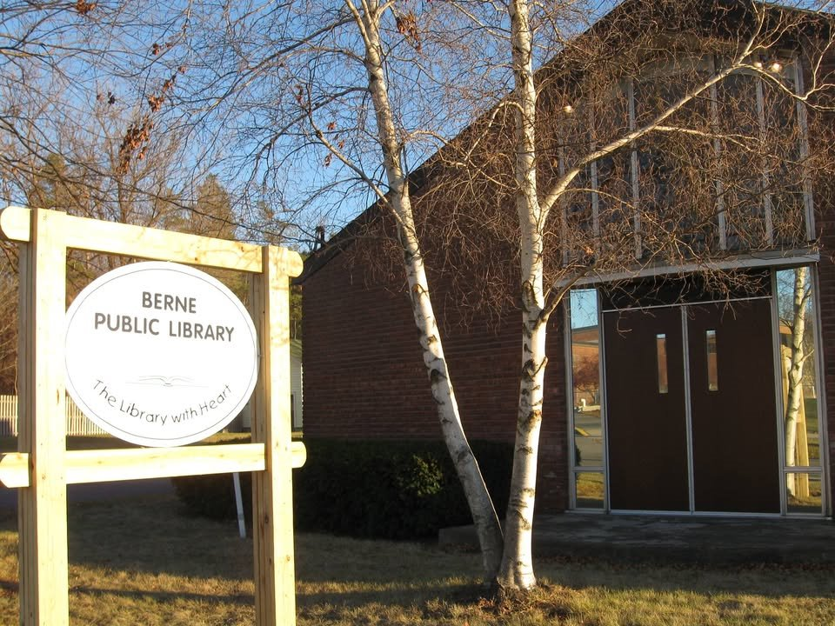
18,602

Slide 8
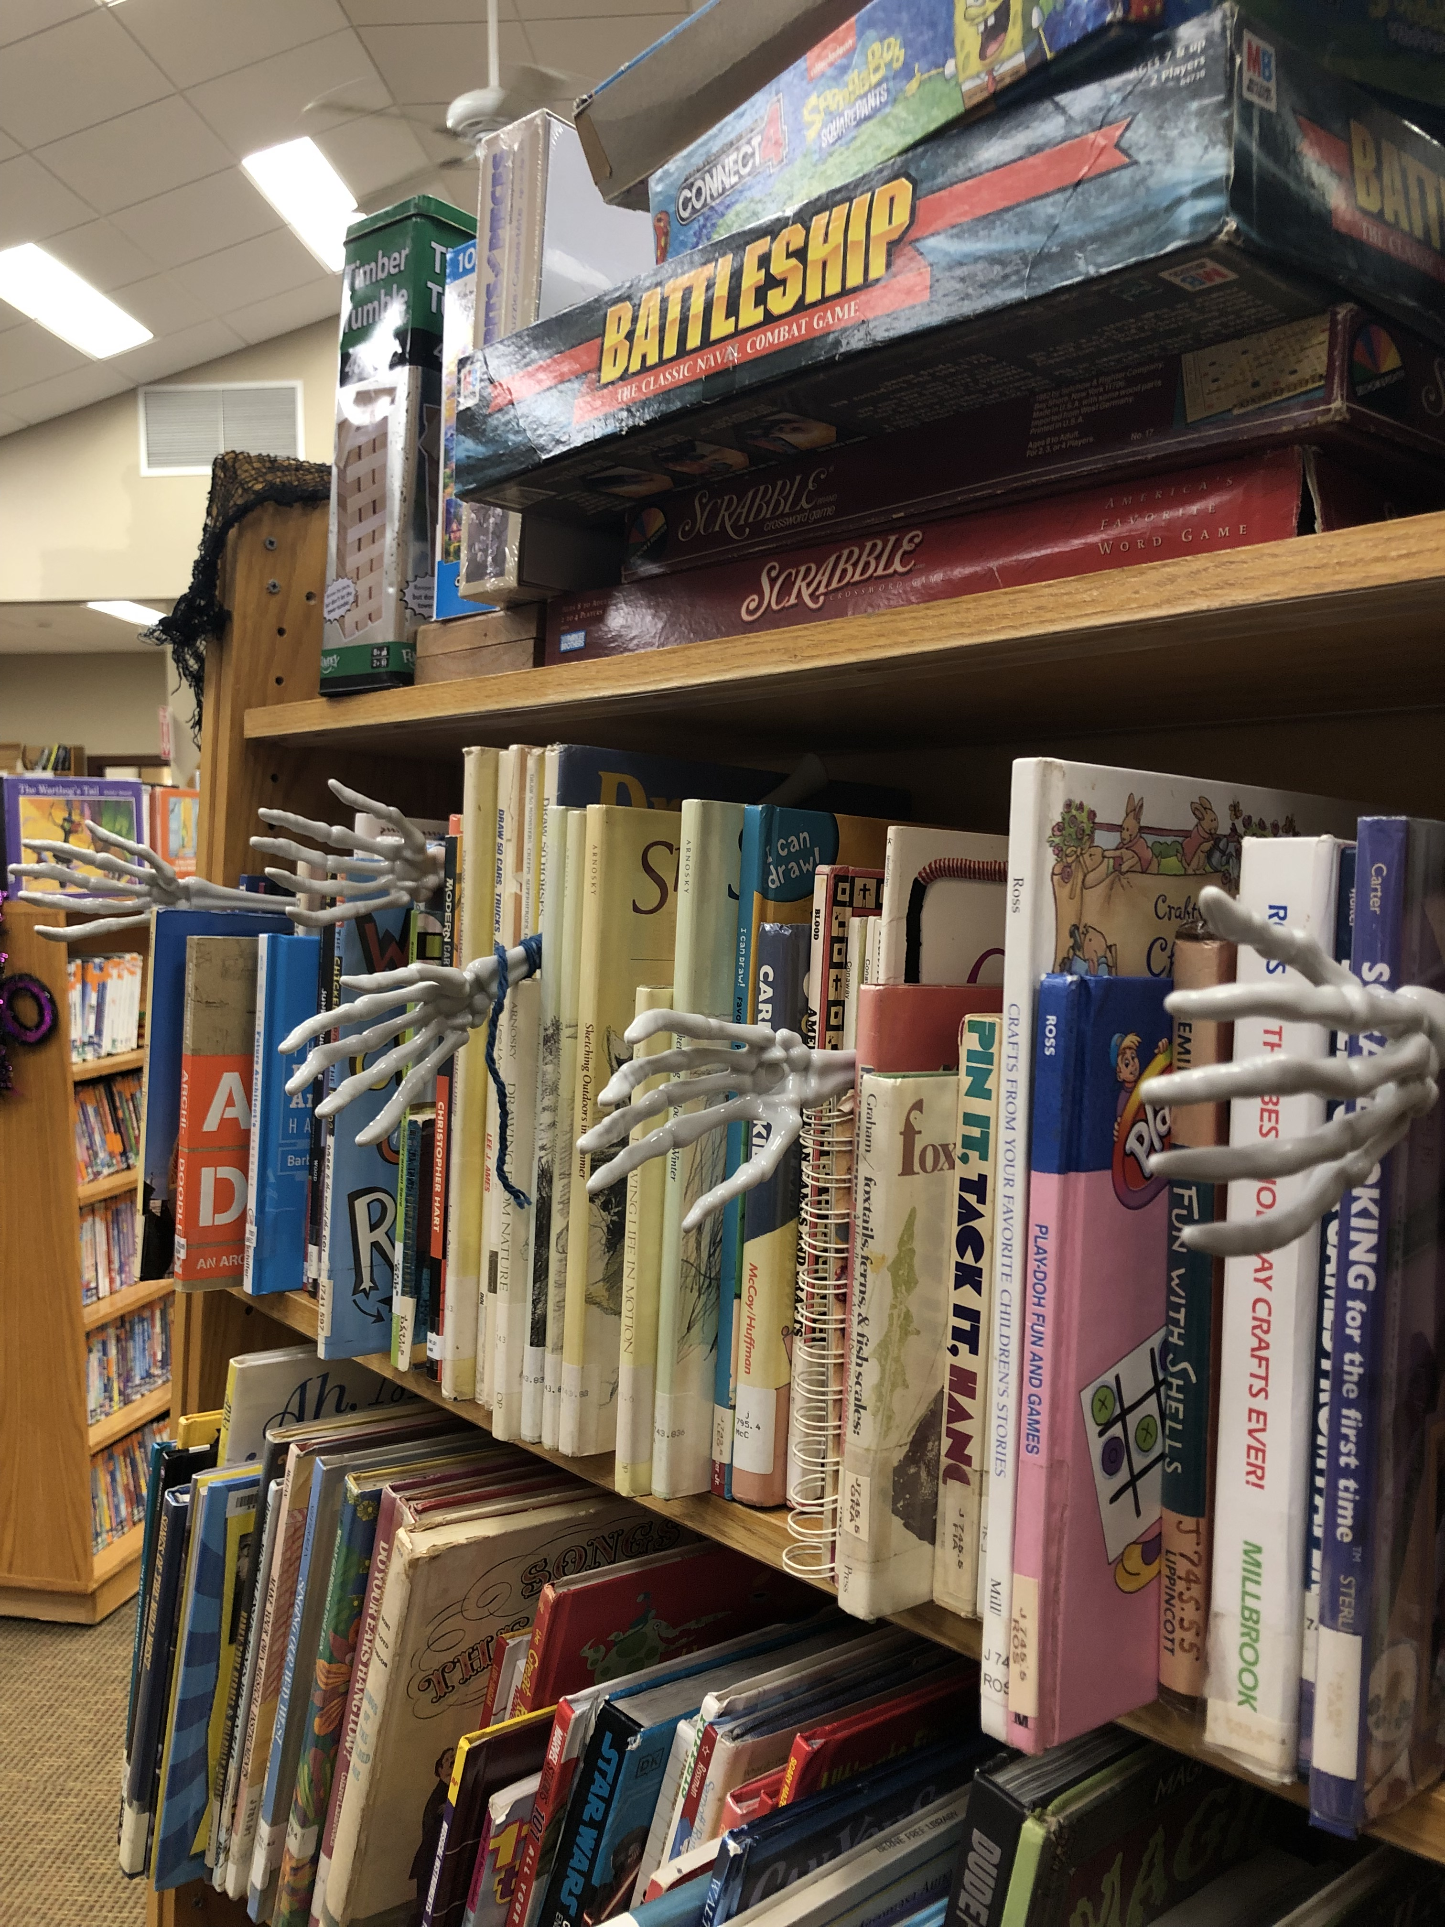
How many items were checked out at the library?

Slide 9

15,932

Slide 10

Let's break that number down.
4,052 Adult books
6,925 Children’s books
4,955 Miscellaneous items checked out – Library of Things, games, tablets, audios, magazines, STEM kits, hotspots etc...

Slide 11

Our library sent 6,028 items to other library's patrons.
Our patron's borrowed 5,492 items from other libraries.

Slide 12
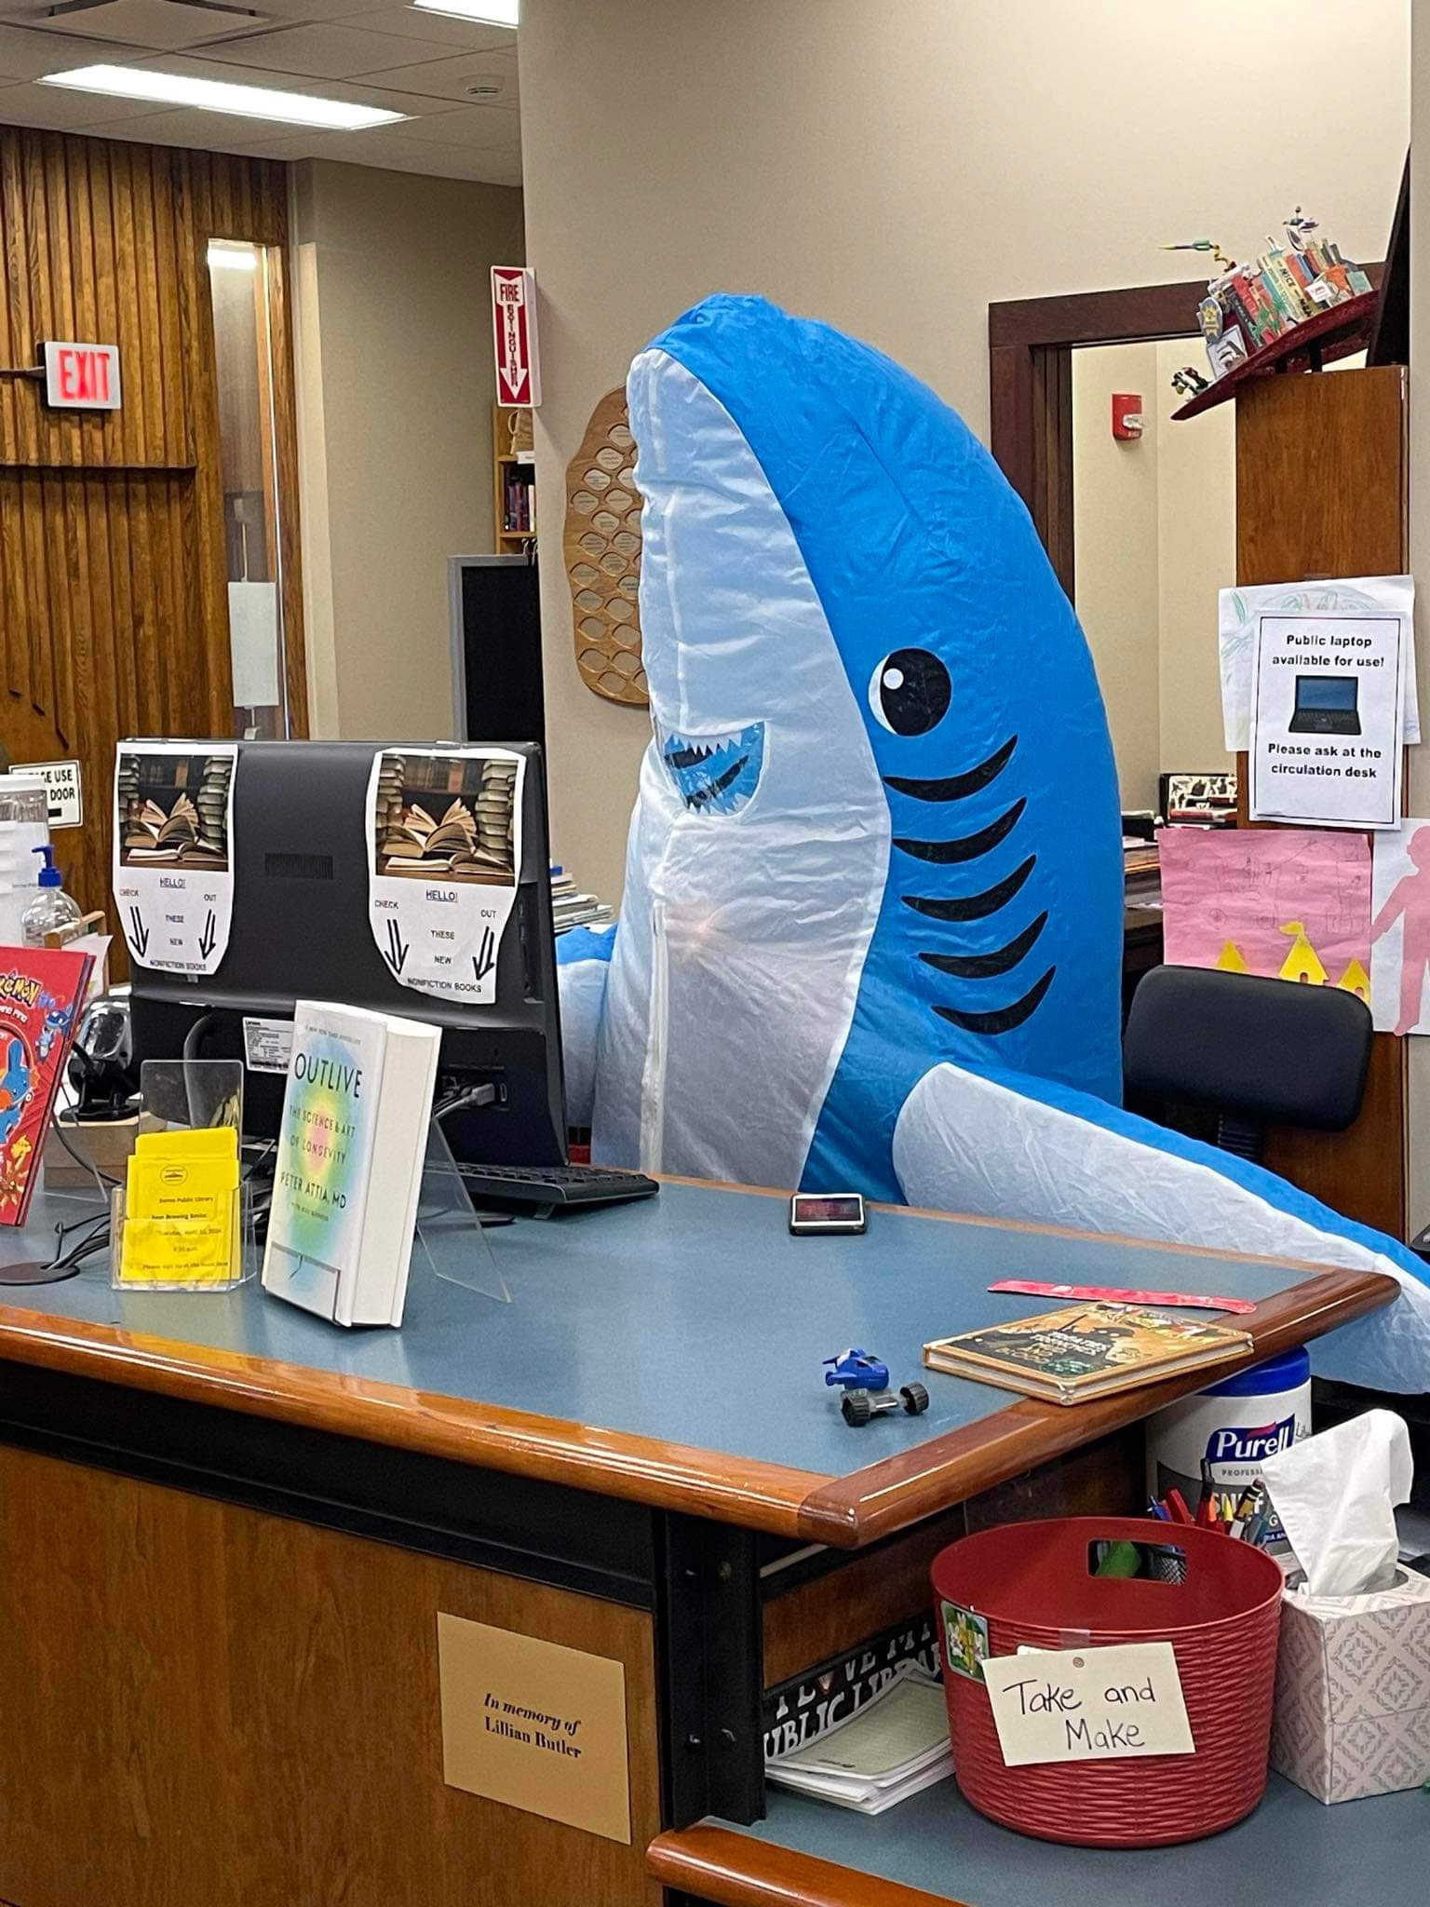
How many programs did the library provide?

Slide 13
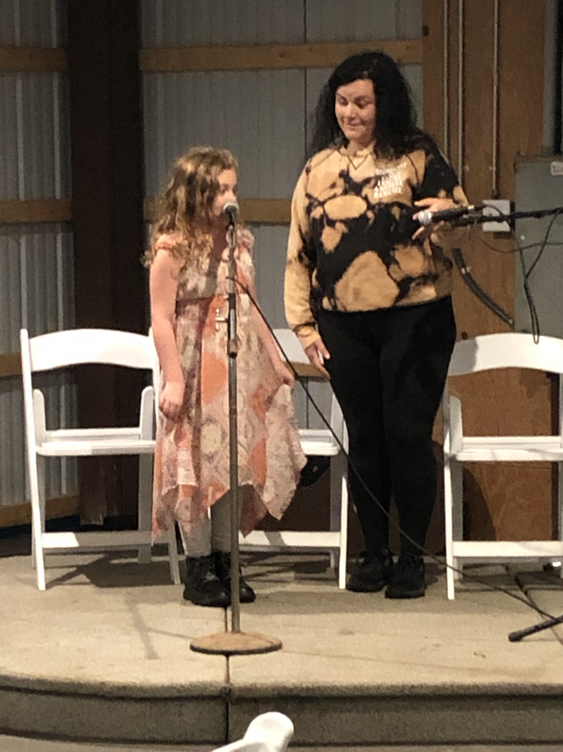
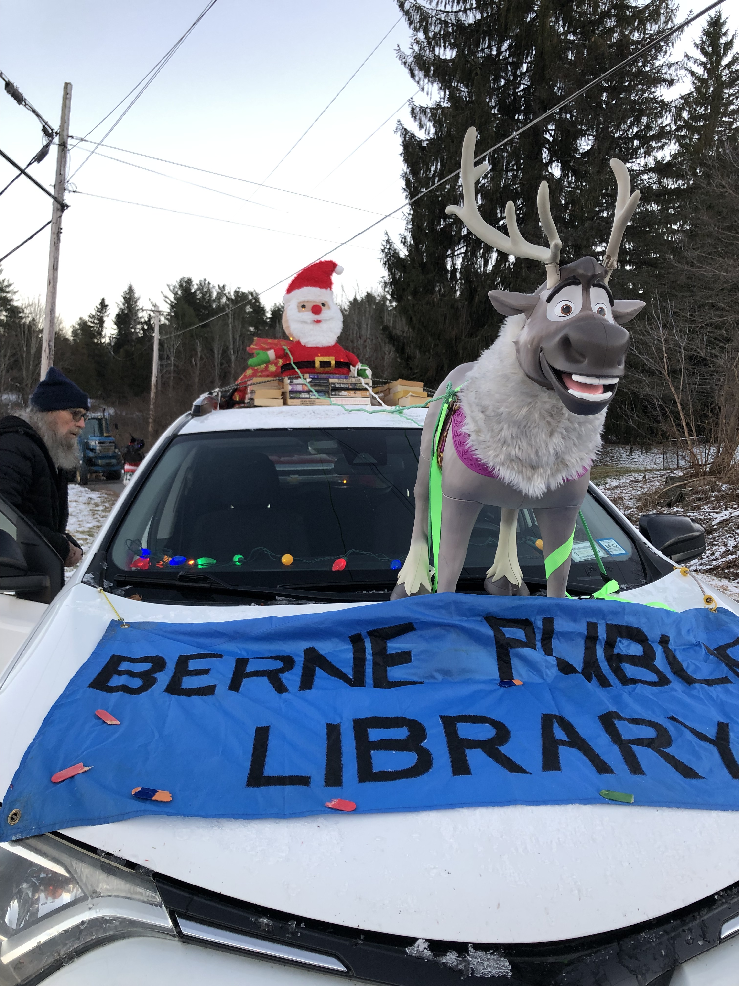
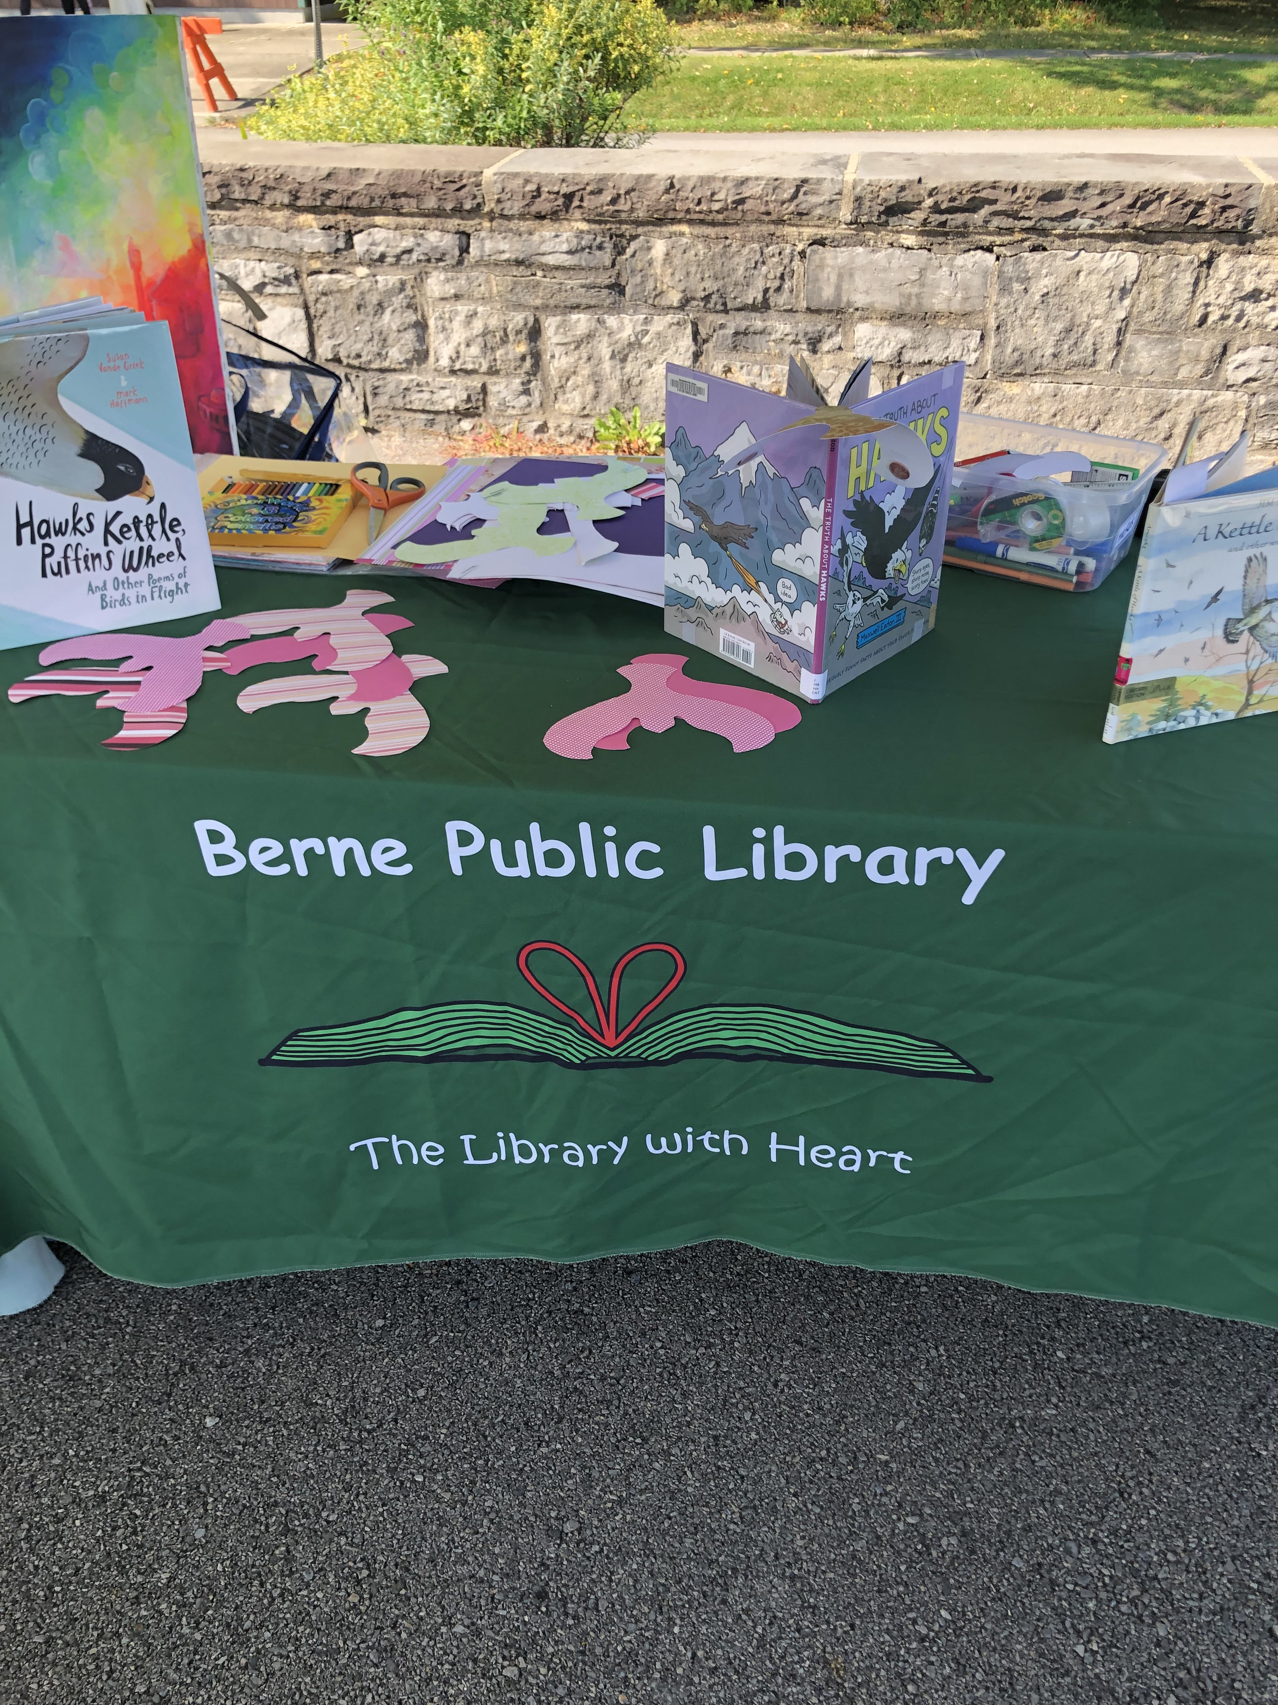
150 programs

Slide 14
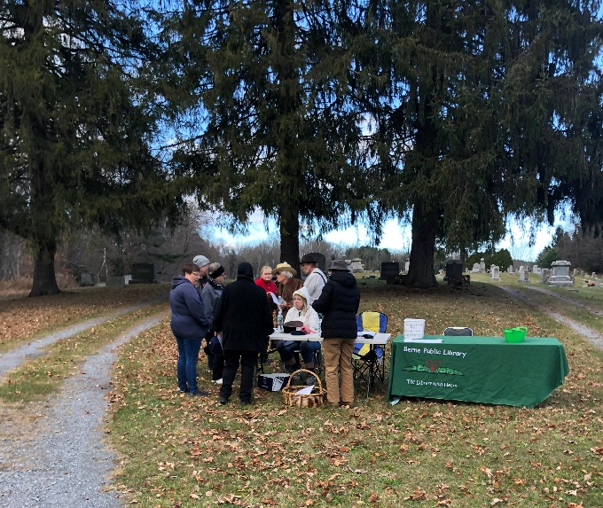
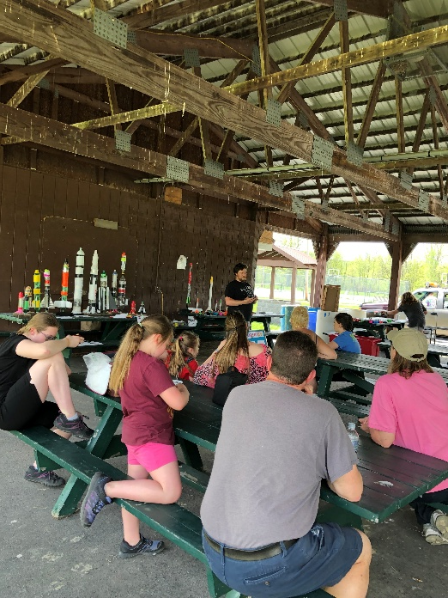
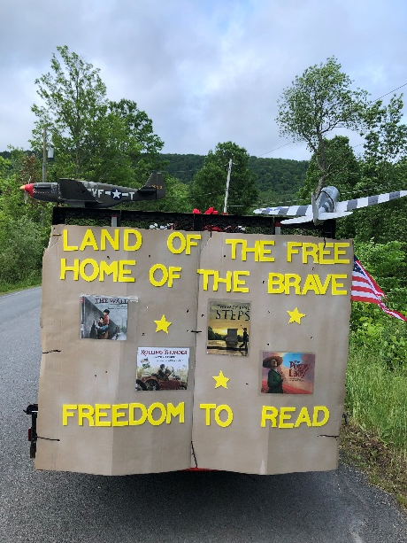
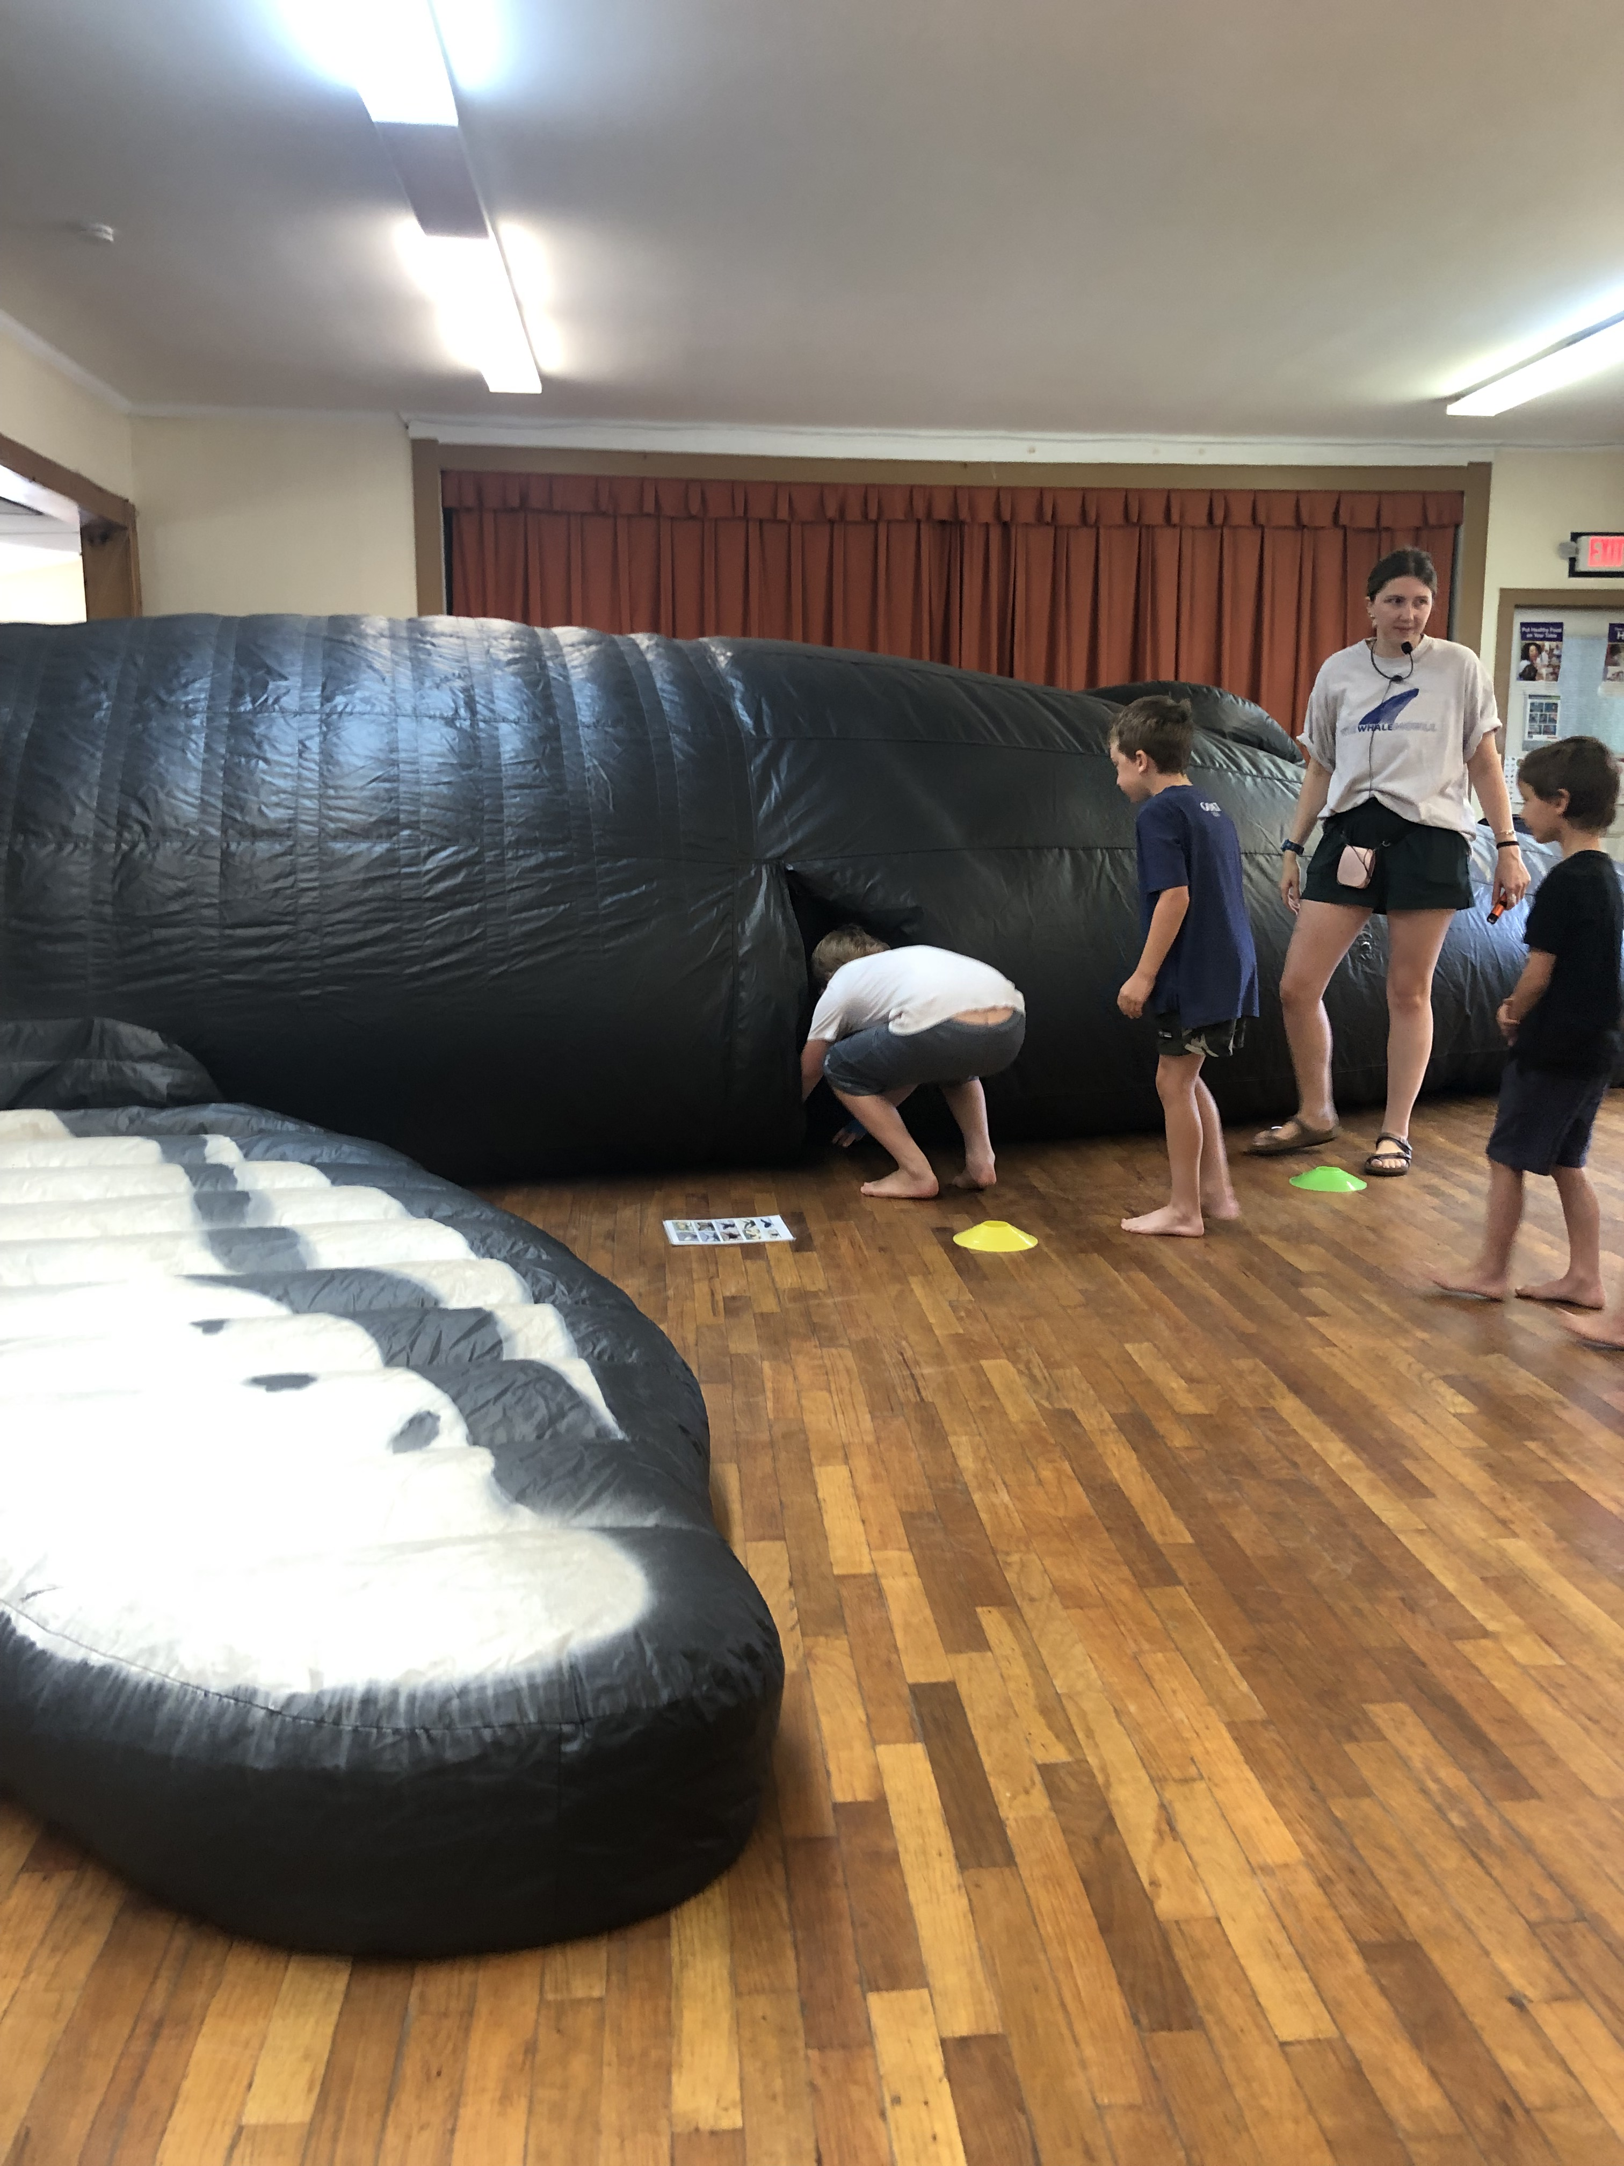
Let's breakdown the program events .
18 off site programs
1,001 attendances

Slide 15
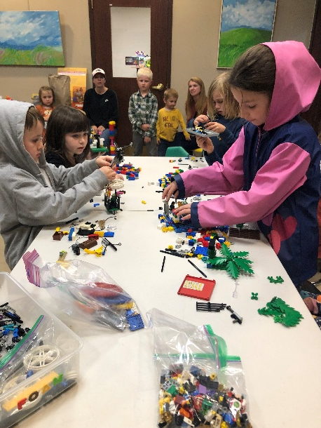
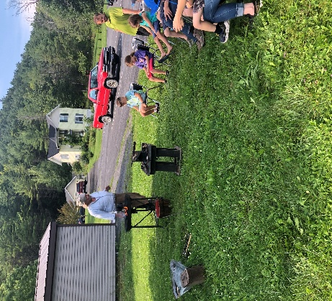
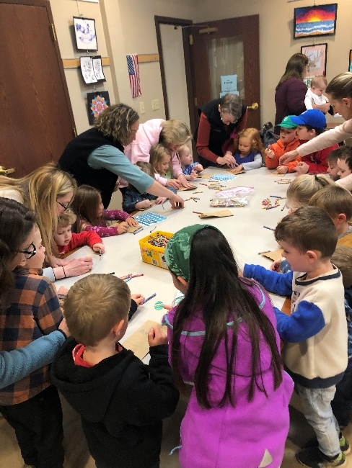
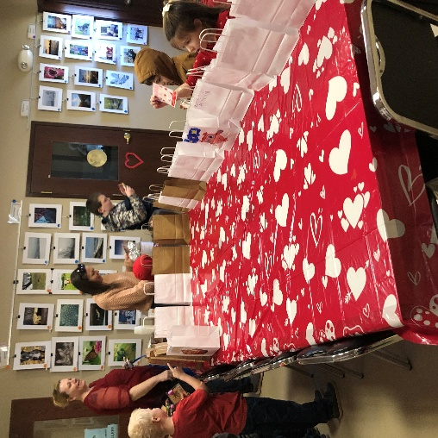
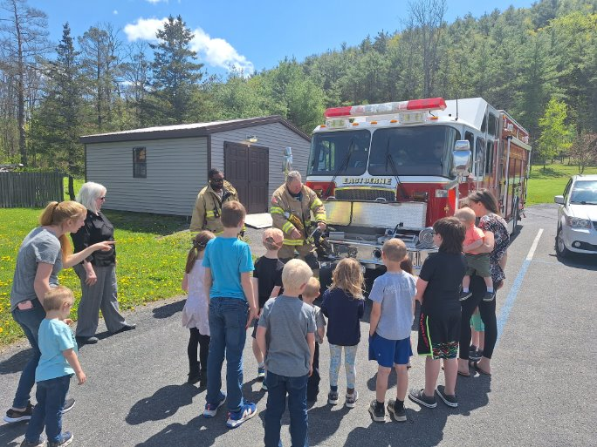
Programs held at the library.
132 Programs
1,976 Attendances

Slide 16
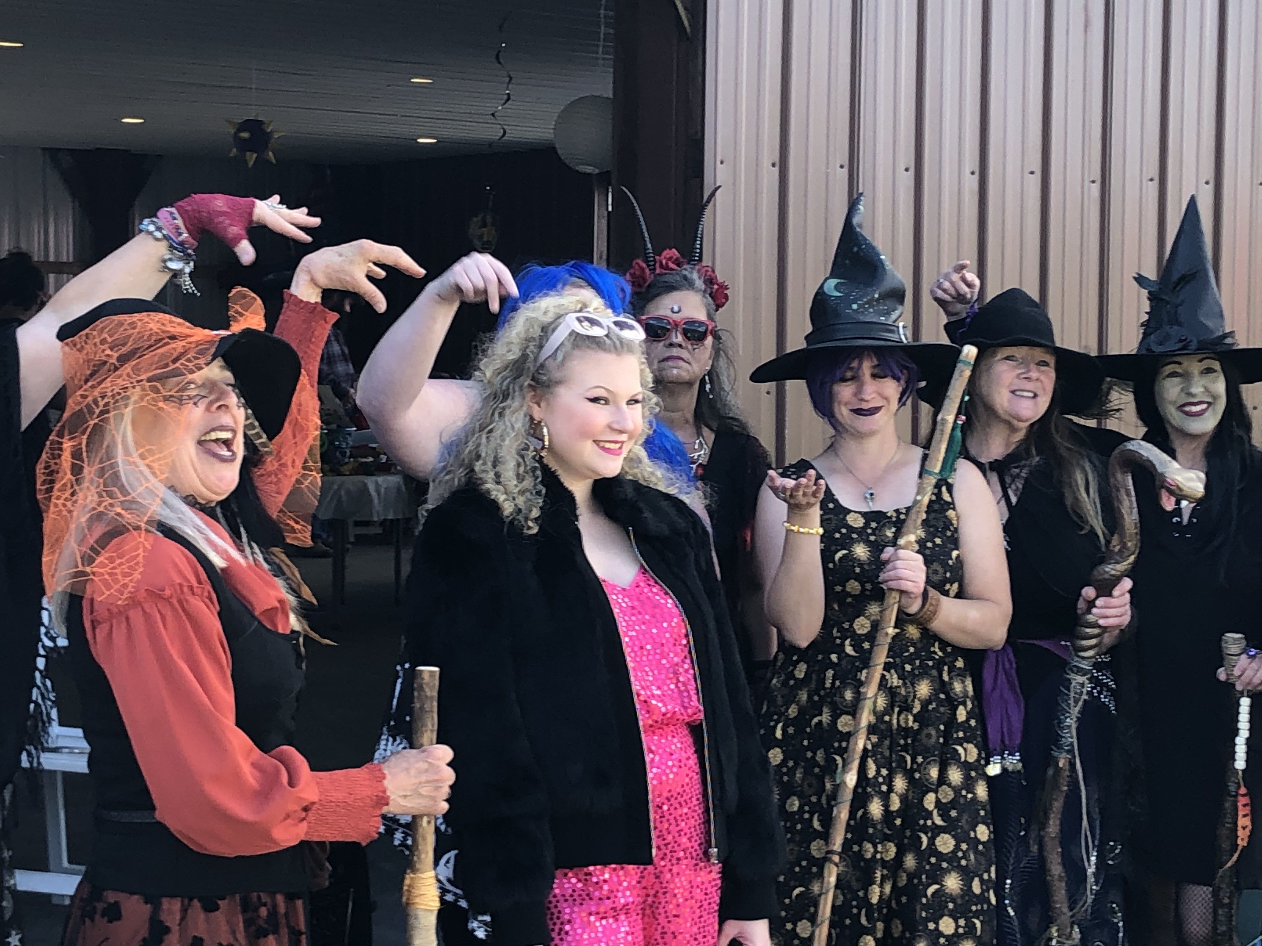
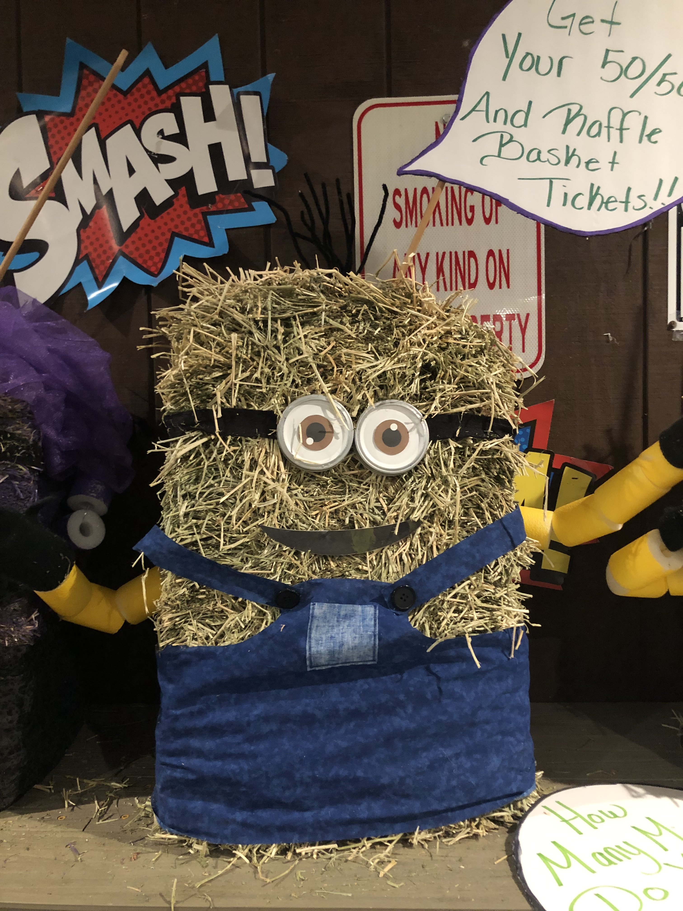
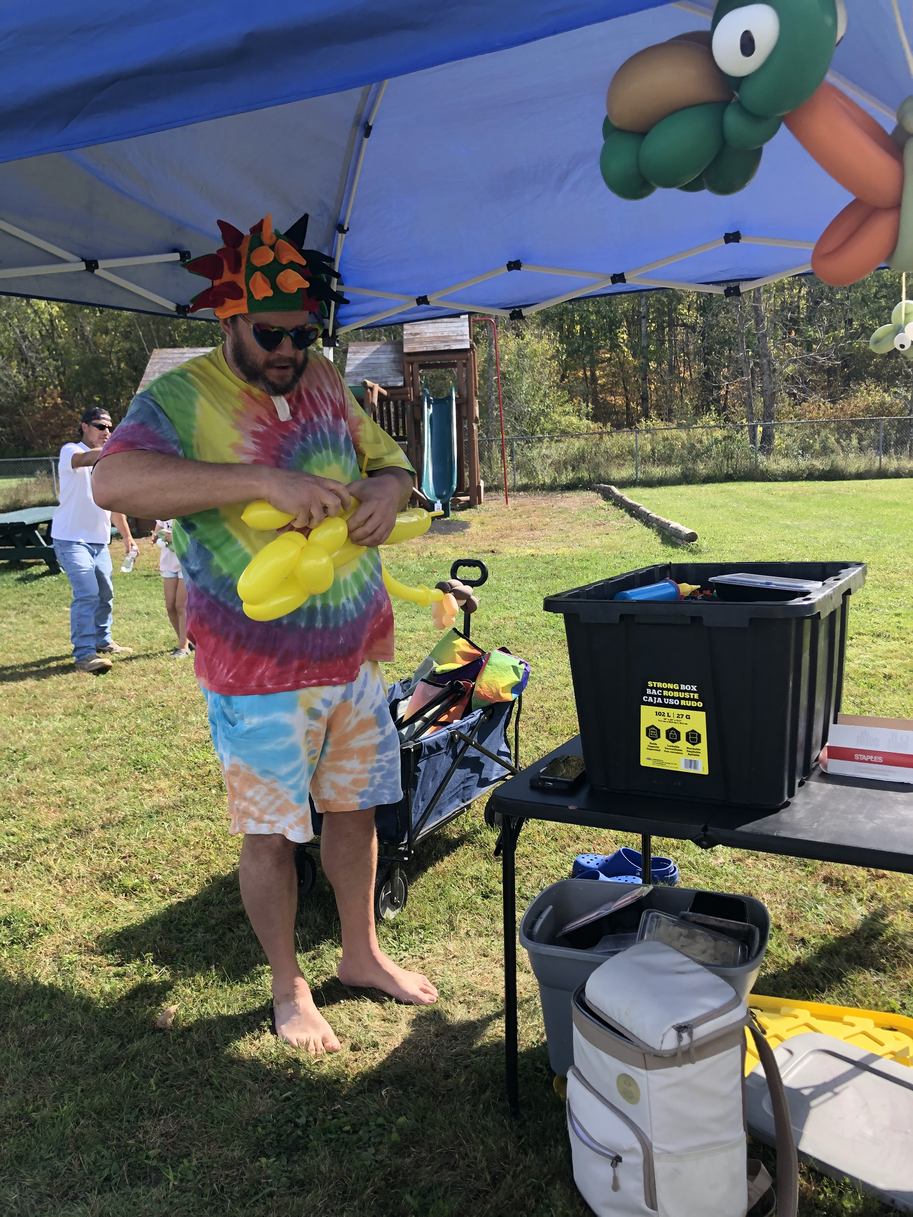
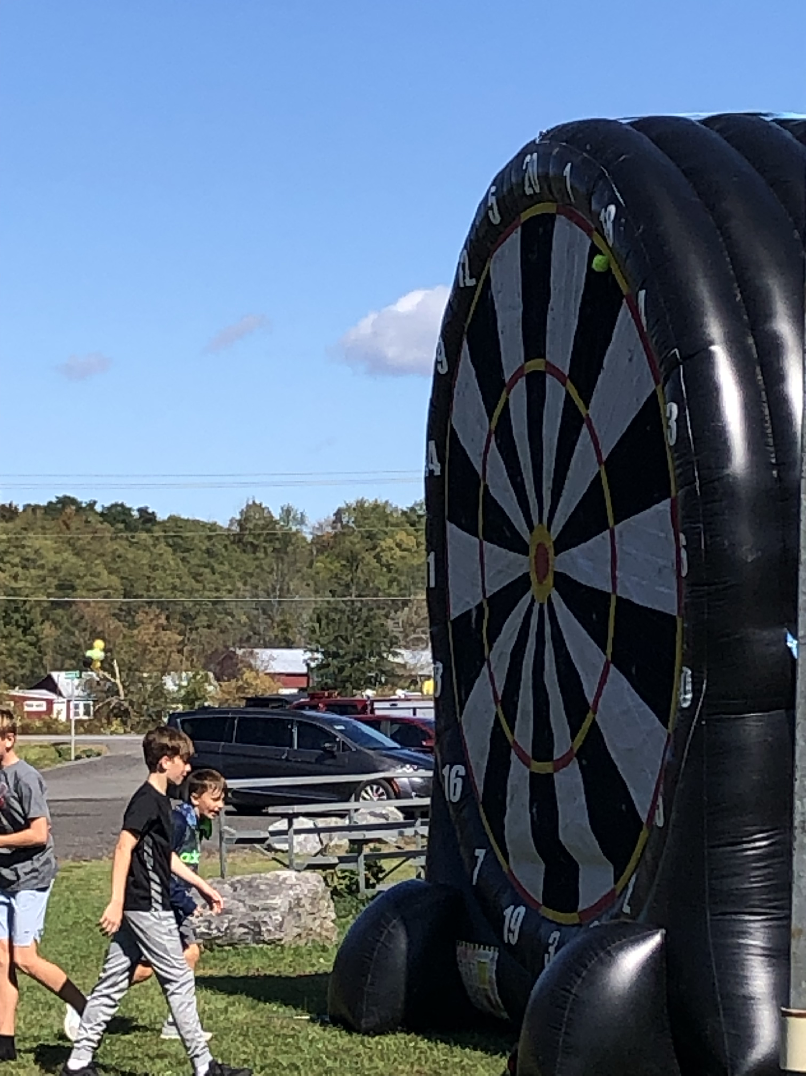
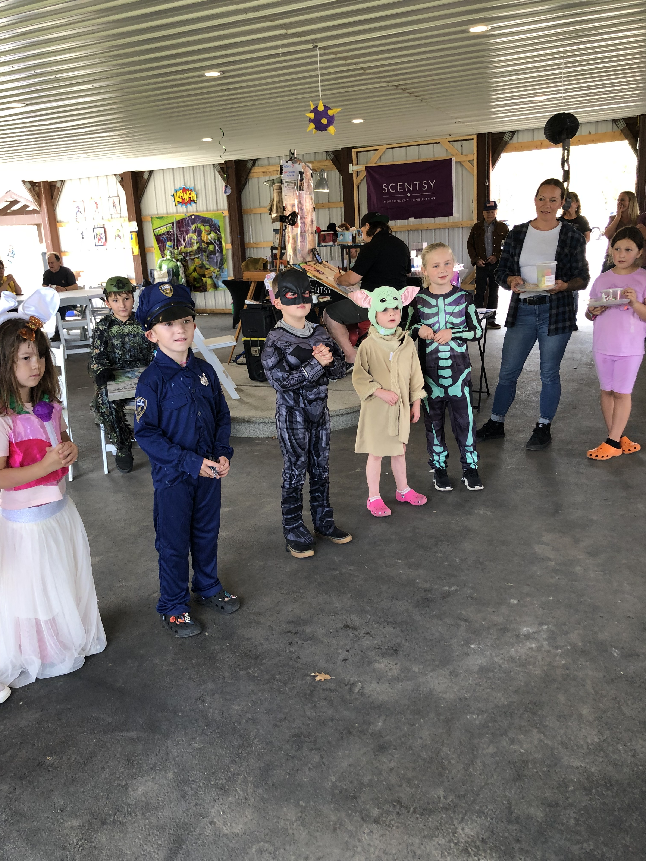
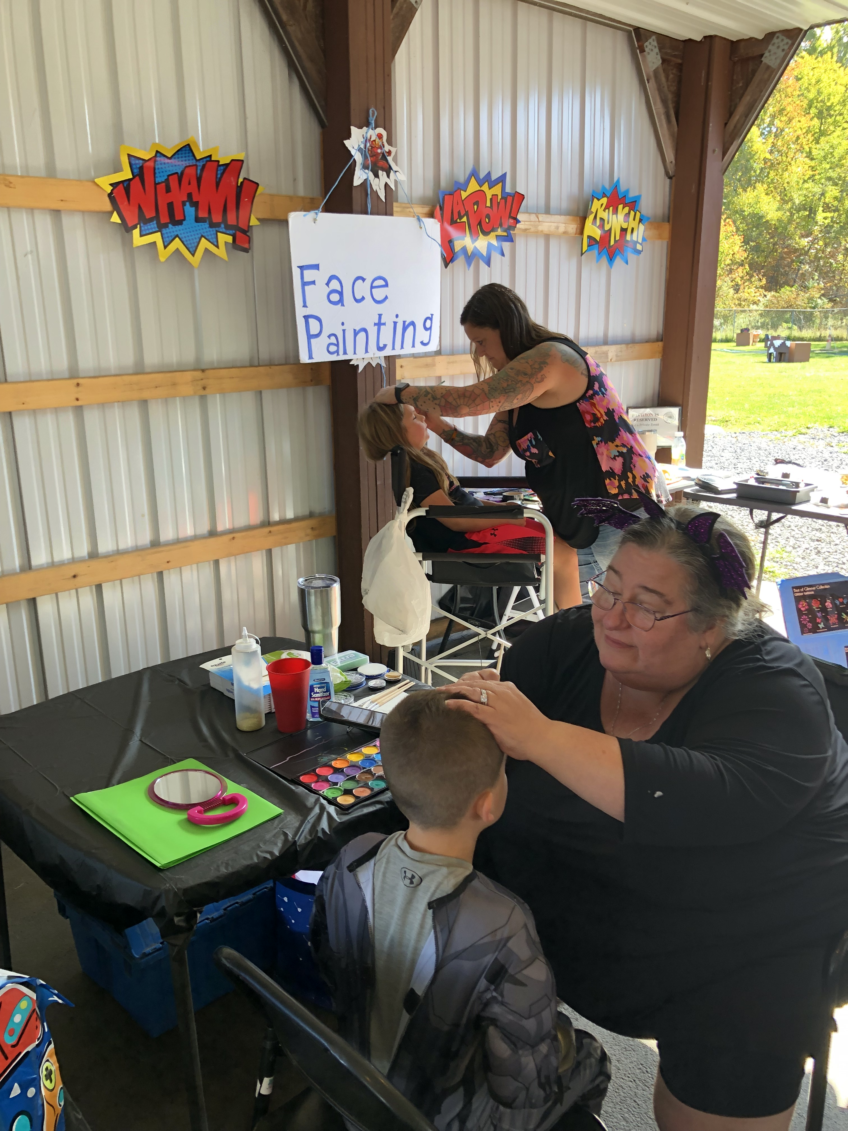
The Incredible Heldercon

Slide 17

How many people used the WiFi?
784 people pinged the Wireless router from their devices.

Slide 18


Digital Content
Libby
ThePhoto by PhotoAuthor is licensed under CCYYSA.
ThePhoto by PhotoAuthor is licensed under CCYYSA.

Slide 19
Digital Data
BERN_2024 (1)

Slide 20
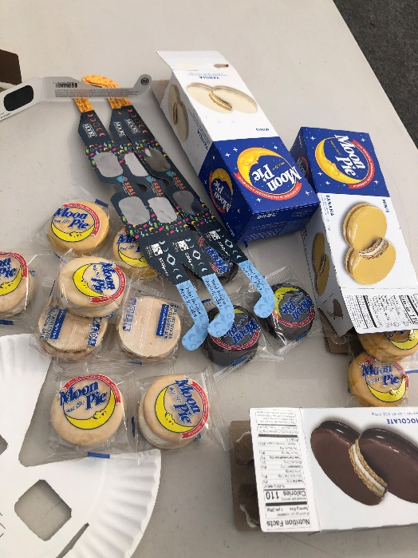
How many free solar glasses did we give away?

Slide 21
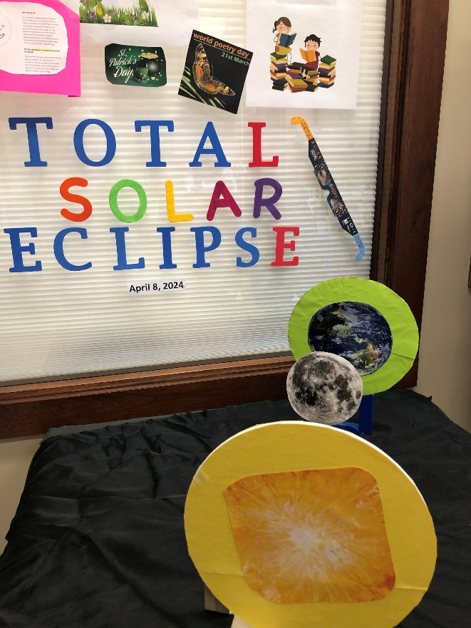
500 +

Slide 22

How many reference calls were answered?

Slide 23

924 +

Slide 24

People who make the library flourish.

Slide 25
Trustees
Lisa Raymond – President
Emilie Wright – V. President
Ted Borys – Treasurer
Jodi Ebel – Secretary
Walter Galicki – Member
Kathy Hill-Brown - Member

Slide 26
Trustees
Lisa Raymond – President
Emilie Wright – V. President
Ted Borys – Treasurer
Jodi Ebel – Secretary
Walter Galicki – Member
Kathy Hill-Brown - Member

Slide 27
Friends of the
Berne Library
Donna Gwin – President
Marion Burghart – Treasurer
Cheryl Jones – Secretary
Many dedicated members.

Slide 28
Staff
Kathy Stempel – Director
Sandra Kisselback – Clerk
Carrie Needham – Clerk
Christine Freer – Clerk

Slide 29


Thank you for everyones support

